Slide 1
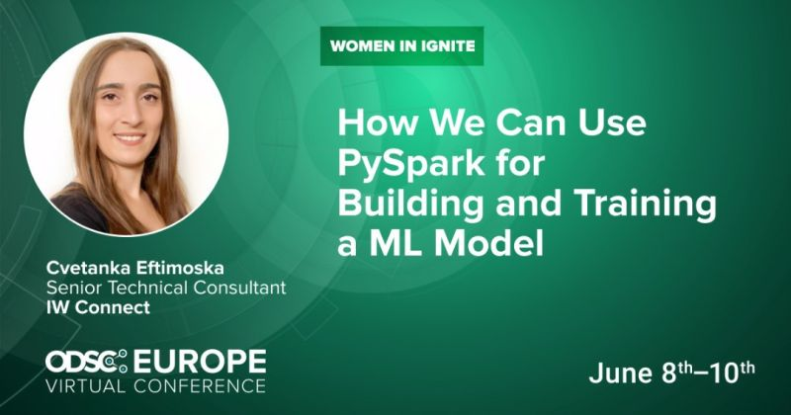

Slide 2




⋮IWConnect at a glance.
Company
Benefits
Partners
Founded in Bitola in 2004
5 offices around the world
Markets: USA and Europe
200 employees
6 different business units
Experts in the field of integration SnapLogic, MuleSoft, TIBCO)
Private health insurance
Full time employment
Free trainings and courses
Professional and personal growth programs
Team building activities
Yearly and monthly awards...

Slide 3
The goal of the presentation.
The concept of AI and Machine Learning
Define PySpark
PySpark Mllib
Example

Slide 4
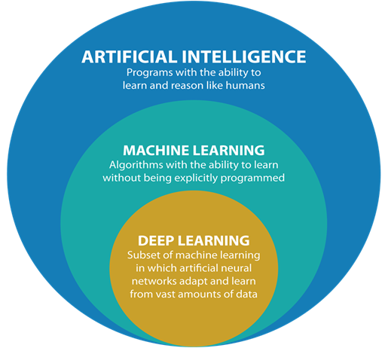
The concept of AI.

Slide 5

Define PySpark

Slide 6
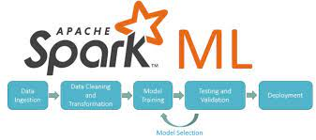
PySpark Mllib

Slide 7
Step 1: Data preprocessing
Handling missing values
Dealing with outliers
Multicollinearity
Dealing with categorical features
Balance the dataset
Standardization / Normalization
Shuffle the data
Split into train and test set

Slide 8
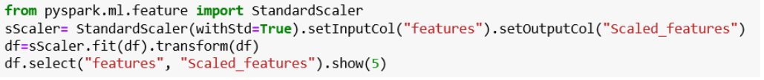
Standardization – example

Slide 9
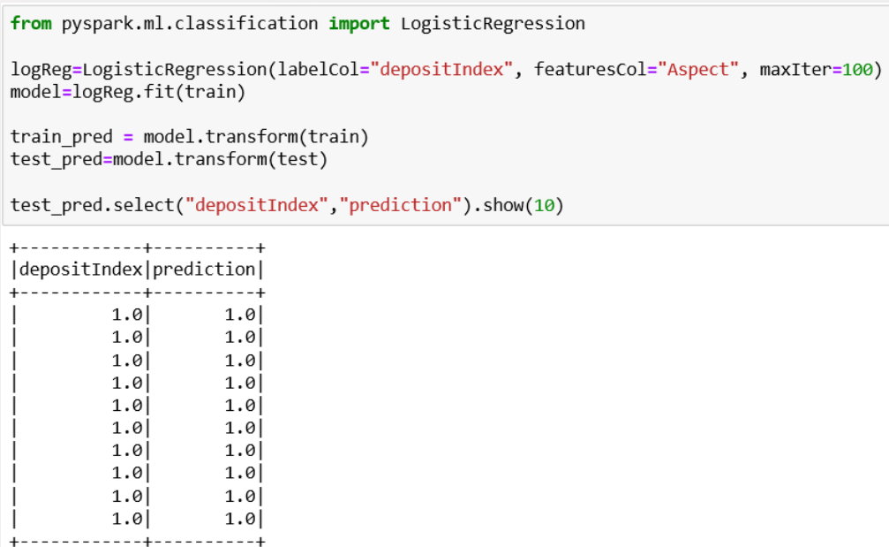
Step 2: Build the model

Slide 10
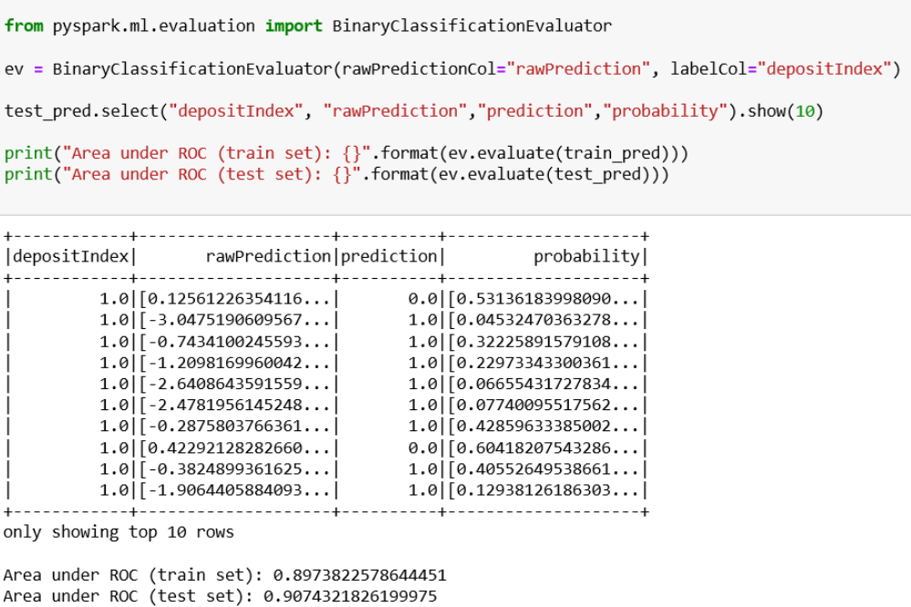
Step 3: Evaluate the model

Slide 11
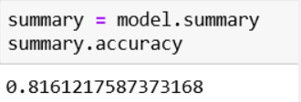
Step 4: Accuracy

Slide 12

Conclusion.

Slide 13



Thank You!
cvetanka.eftimoska@iwconnect.com
iwconnect life_at_iw
Follow us 👇
.com/iwconnect

